Slide 1


SMALL BUSINESS SHOWCASE
Corporate Snapshot
8(a)/SDB, MBE
CMMI DEV 1.2 Maturity Level 3
Protégé to SAIC – Treasury (New Blood)
DSS Cleared facility
10 year old firm, Federal since 2006
Current Federal Vehicles
GSA IT Schedule 70
GSA MOBIS
GSA Alliant
Niche Areas
Enterprise Reporting / Dashboard & Scorecards (Business Intelligence)
Data Integration
Financial Services Ex: $3.1 Million - National Cooperative Banks (Data Warehouse & Database Administration)
b.i.methods has no direct project past performance with the IRS – Protégé to SAIC
3

Slide 2





















b.i.methods Representative Clients

Slide 3
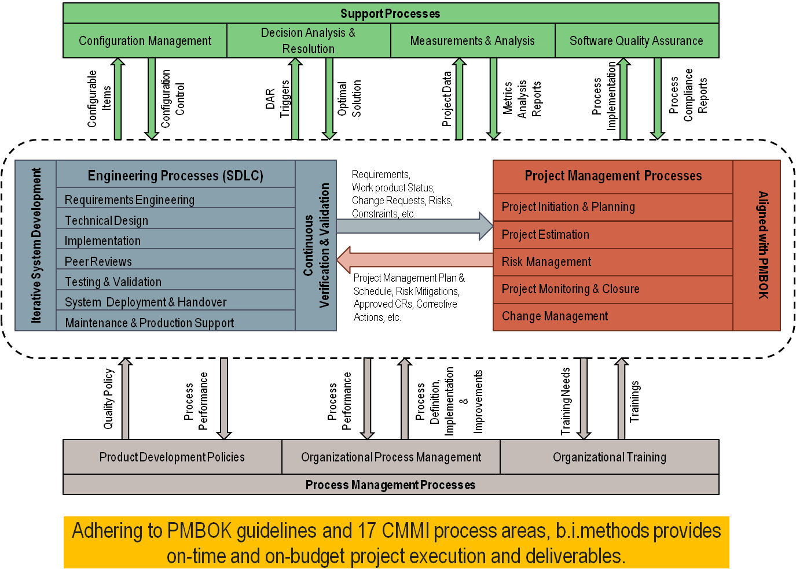
CMMI 3 / PMBOK Aligned SDLC
PMBOK Aligned Process Architecture
Benefits to our clients and partner
High Consistency
High Efficiency
High Transparency
High Value
Low Risk

Slide 4
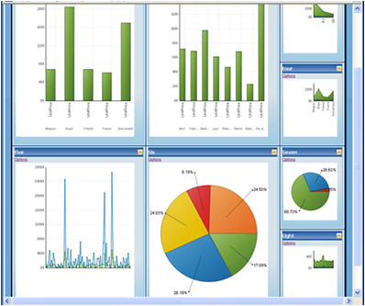
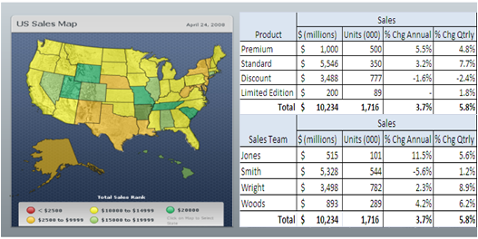
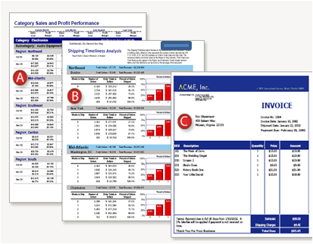
Business Intelligence Services
Enterprise Reporting / Dashboard & Scorecards — Allow greater business performance management across organizational, functional, and project/product dimensions via Key Performance & Risk Indicators (KPIs/KRIs) at an aggregate, cross-enterprise level by delivering customizable trend reports and statistical visualizations with configurable thresholds and control limits.
User Needs Assessment — Understanding the complex mix of reporting and analysis goals across a wide variety of business user types is key to making a business intelligence initiative successful.
Analytics and Mining — b.i.methods data analysts have worked with large, complex data sets across financial, insurance, health-related, and logistics subject areas, to name a few.
Data Warehouse/Data Marts/Operational Data Stores (ODS) — Organizations often face the challenge of needing to physically pull large set of data together across multiple source systems in support of reporting, analytic, and performance management needs.
Analysis Across multiple dimensions:
Product, Location, Resource, Time etc.
Pre-Canned, printable reports delivered
to web-site or via e-mail
Interactive, intuitive dashboards for better performance management
Notes:
4

Slide 5
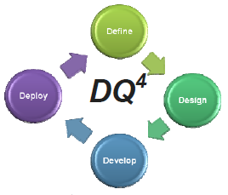
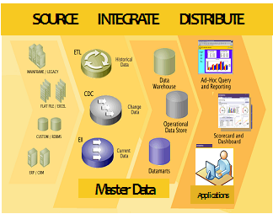
Data Management Services
Data Integration— Exchanging and aggregating data across disparate processes, organizations, formats, semantics, and technologies in support of interoperability, vertical and horizontal supply chains, and enterprise-wide decision making
Data Quality & Governance — Continuous improvement of data’s “fitness for use” and operating models to ensure highly leveraged, highly consistent, and highly transparent information assets
Master and Metadata Management — Unique identification, reuse, and authoritative sourcing of key information subjects in a highly understandable and well-defined manner
Data Quality Framework
Data Integration
Notes:
5

Slide 6
QUESTIONS?
12310 Pinecrest Road
Suite 202,
Reston VA 20191
Email: jjones@bimethods.com
Tel: 703.889.8500 ext 116

