Slide 1
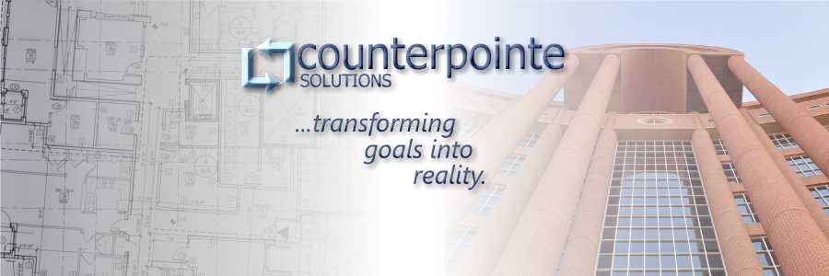
2010 Small Business Showcase
March 22, 2010
8(a) Certified Small Business

Slide 2

Company Overview
8(a), SDB Company
Provide Software Development, Program Management and ARCHIBUS Implementation services
Experience at IRS, USDA, DHS and HUD
2 prime contract at IRS
  GDI O&M (Contract Value=$ 2,368,740)
  GDI Admin Support (Contract Value = $ 1,469,969)

Slide 3
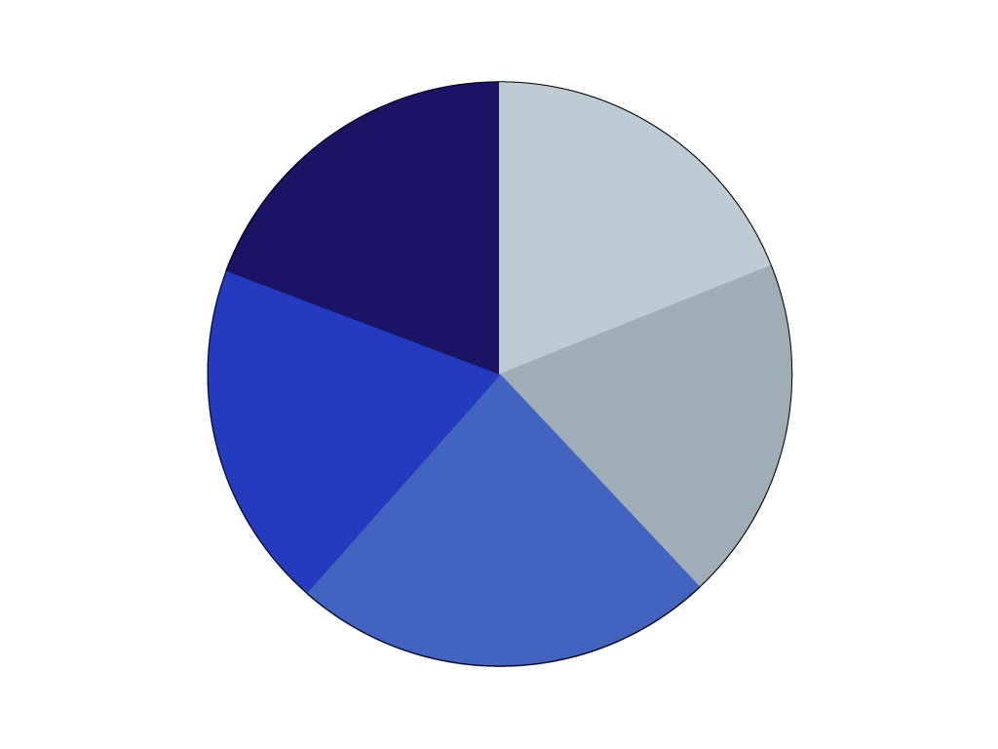




Software Development
Technical Experience
Iterative Development
Iterative Development
Modernization
  Portals
  Integration Services
Maintenance and Operations
FISMA Compliance
CMMI Level 3 processes
.NET, J2EE, SQL, Oracle, SOA, Open Source

Slide 4
Program Management
Project Management
Initiation
IT Capital Planning Process
Alternative Analysis
Planning
Project Plan Development
Requirements Development
Monitoring and Control
Risk Management
Compliance support
Testing Support
Execution
Requirements Management
Manage day to day activities
Training Development

Slide 5
ARCHIBUS Implementation
Integrated solution for Real Estate, Infrastructure and Facilities Management
Data-centric solution
Intelligent dashboards and reports
Streamlined business process through workflows
SOA / Web Services
Business Intelligence
Facilities
Management
Property
Management
Enterprise Infrastructure Modeling
Workflow Management
Technology
Management
Operations
Management

Slide 6

Counterpointe Solutions
Process
People
Technology
Communication
…transforming goals into reality.

