Slide 1

IRS Collectability Curve
Taxpayer Advocate Service
Research & Analysis
June 2015

Slide 2
Focus
Taxpayer Delinquency Account (TDA) liabilities.
Individual Master File
Collection statute (generally 10 years)

Slide 3
Background
Over 50 percent of the IRS Individual Master File (IMF) TDA inventory has been in the function assigned the delinquency for at least 10 months.
Over 70 percent of the IMF TDAs in IRS inventory at the end of 2014 are Tax Year 2010 and prior liabilities.
Over 20 percent of the IMF TDAs have less than four years remaining on the collection statute, meaning that the delinquency has existed for over six years.

Slide 4
Objectives
Determine dollars collected during each year after TDA assignment.
Distinguish between TDA dollars collected from subsequent payments and offsets.
Determine how dollars collected vary by categories of TDA balance due.

Slide 5
Objectives
Determine how TDA dollars collected vary by type of assessment (self-reported and IRS imposed)
Quantify the effect of assessed penalties and interest on the TDA balance due.
Determine the percentage of TDA liabilities abated by the IRS and if abatements vary by sources of assessment.

Slide 6
Objectives
Determine the percent of TDA cases full paid within 10 years.
Determine if TDA dollars collected vary by collection channel.

Slide 7
Methodology
Analyzed balance due (from IMF ARDI) at initial TDA assignment.
Analyzed cases entering TDA status (by year entered) from calendar year 2003 through 2012.
Used IMF data to distinguish between subsequent payments, offsets, penalties, interest, and adjustments (classified by transaction code).

Slide 8
Methodology
Used ARDI major source of assessment to determine type of IRS assessment (self-assessed or IRS imposed).
Used TRCAT code to determine if case was assigned to ACS, collection queue, or CFf.

Slide 9
Limitations
Changes in module balances include assessed and accrued penalties and interest; however, the specific finding on penalties and interest only includes assessed amounts.
Amounts abated because of accepted offers in compromise are included in the sections on abatements; however, in FY 2014, accepted offers in compromise only accounted for about one percent of the initial TDA balance.

Slide 10
Findings
Dollars collected generally decreased by more than 50 percent from the first year to the second year.
In the third year, collections decrease by about a third from the amount collected in the second year.

Slide 11
Findings – Percent of Payments Collected per Year

Slide 12
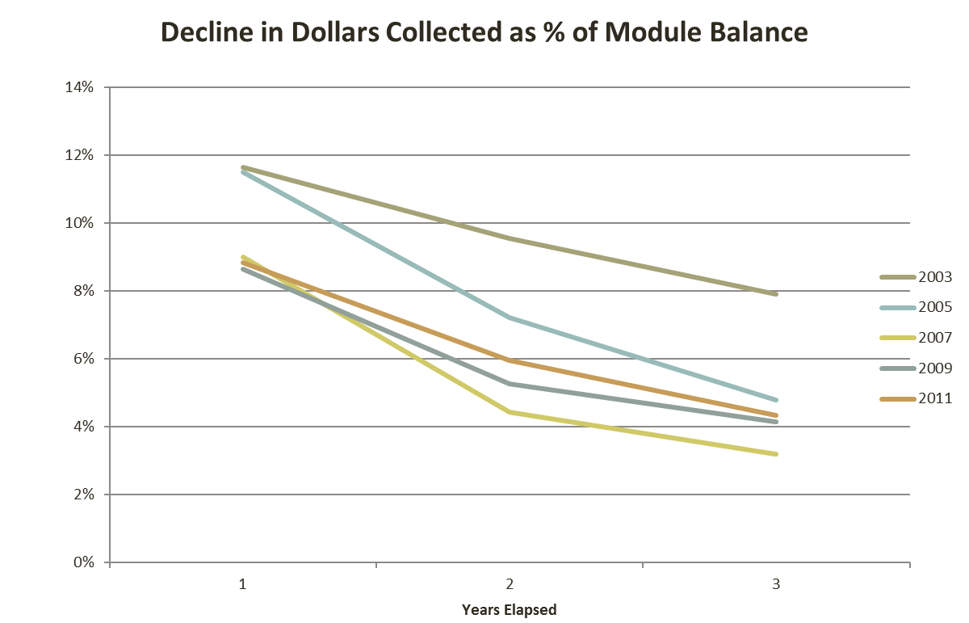
Findings - Dollars collected also decline as a percent of the available balance.

Slide 13
Findings – Dollars Collected by Subsequent Payment Have Decreased
In the earlier years, dollars collected by subsequent payment are nearly triple dollars collected through offset however, in more recent years, this margin has decreased to only double.
Overall, dollars collected on TDAs by subsequent payment appear to be decreasing from 2003 to 2012.

Slide 14
Findings – Percent of Dollars Collected vary by TDA Balance
Nearly Three-quarters of TDAs have balances of $5,000 or less.
However, over 80 percent of the balance owed is contained in TDAs with balances above $5,000.
The IRS Collects a Higher Percentage of dollars when the TDA Balance is Smaller.

Slide 15
Findings – Percent of Dollars Collected vary by TDA Balance
The IRS offsets the highest percent of dollars to TDAs under $5,000.
As time progresses, the percent of TDAs with initial balances of $5,000 or less are decreasing, while the percent of the total initial TDA balance above $5,000 is increasing.

Slide 16
Findings – Source of Assessment
On a percentage basis …
The IRS Collects twice as much from TDAs resulting from self-assessments than from audit assessments.
In recent years, the IRS also collects about twice as much from TDAs resulting from self-assessments than AUR assessments (the difference was not quite as large in earlier years).

Slide 17
Findings – Source of Assessment
The IRS generally collects the least on SFR assessments.
The IRS collects the highest percentage from offsets on TDAs from AUR assessments.
The IRS generally offsets a slightly higher percentage on TDAs from audit assessments than self-reported assessments.

Slide 18
Findings – Source of Assessment
Subsequent Payments
Offsets
Year | Self-Reported Assessments | Substitute for Return | Audit Assessments | AUR Assessments | Trust Fund Recovery Penalties
2003 | 56% | 14% | 23% | 33% | 16%
2005 | 60% | 13% | 28% | 31% | 17%
2007 | 51% | 10% | 24% | 25% | 12%
2009 | 45% | 9% | 21% | 24% | 9%
2011 | 40% | 7% | 15% | 21% | 8%
Year | Self-Reported Assessments | Substitute for Return | Audit Assessments | AUR Assessments | Trust Fund Recovery Penalties
2003 | 18% | 4% | 12% | 34% | 6%
2005 | 20% | 5% | 20% | 32% | 6%
2007 | 20% | 5% | 25% | 36% | 6%
2009 | 15% | 4% | 20% | 28% | 6%
2011 | 10% | 2% | 12% | 25% | 4%

Slide 19
Findings – Assessed Penalties and Interest
Over equivalent three year periods, assessed penalties and interest have remained relatively constant; however, when sufficient time has elapsed, penalties and interest are increasing.

Slide 20
Findings - Abatements
Generally, the IRS abates from a quarter to a third of TDA assessments.
Year | Initial TDA Balance | $ Abated | % Abated
2003 | $15,326,191,192 | $2,985,977,270 | 19%
2005 | $25,996,084,845 | $8,066,761,341 | 31%
2007 | $40,678,451,308 | $13,086,103,480 | 32%
2009 | $41,987,700,518 | $10,716,623,485 | 26%
2011 | $42,926,217,917 | $11,990,870,525 | 28%

Slide 21
Findings - Abatements
SFR assessments have the highest abatement rate (nearly 50 percent in some years).
Abatements attributable to AUR assessments are growing, while self-reported assessments are the least likely to be abated.

Slide 22
Findings – Abatements by Source of Assessment
Year | Self-Reported Assessments | Substitute for Return | Audit Assessments | AUR Assessments | Trust Fund Recovery Penalties
2003 | 6% | 49% | 15% | 15% | 39%
2005 | 6% | 47% | 12% | 29% | 40%
2007 | 12% | 43% | 14% | 28% | 35%
2009 | 9% | 36% | 13% | 27% | 28%
2011 | 16% | 40% | 19% | 18% | 29%

Slide 23
Findings – Full Payments and Collection Channel
The full payment rate has been decreasing for TDAs issued in more recent years, while a higher percentage of the initial TDA liability remains due.
ACS collects a higher percent of TDA dollars by both subsequent payment and offset than CFf (may be a reflection of inventory composition).
Often, over a third of TDA dollars assigned to CFf are abated.

Slide 24
Conclusions
Dollars collected in aggregate and as a percent of the balance due decrease significantly during the first three years after the IRS assigns a liability to TDA status.
When continuing to look at the collection of liabilities after the third year of the initial TDA assignment, collections continue to dwindle and the reduction in the module balance declines almost completely.
Overall, dollars collected through the offsets of other overpayments are much less than dollars collected through subsequent payments.

Slide 25
Conclusions
Delinquent modules with balances due not in excess of $5,000 comprise the vast majority of TDAs. However, over 80 percent of the total amount due resides with TDAs with balances greater than $5,000.
The IRS collects both a higher percentage of subsequent payments and offsets in the lowest balance due categories.
The percent of the TDA balance collected is significantly greater for self-reported liabilities than when the IRS makes additional assessments.
Penalty and interest significantly increase the balance owed by taxpayers, particularly when the underlying balance remains unresolved for several years.

Slide 26
Conclusions
The IRS abates between a quarter and a third of TDA liabilities. The IRS abates about 40 to 50 percent of its substitute for return (SFR) assessments.
The IRS completely resolves most of its TDA modules within the 10 year collection statute, with a resolution rate of about 80 percent for TDAs assigned in 2003 and 2005. Unfortunately, the percent of TDAs resolved appears to be declining for TDAs initiated in later years. Additionally, the balance owed on these delinquencies has only been reduced by less than 50 percent.
ACS realizes the largest percent of TDA balances collected by subsequent payment and offset. While the percent of dollars abated is high in all TDA collection channels, the abatement rates are significantly higher in the queue and CFf than in ACS.

