Slide 1
Individual Non-Filers and IRS Generated Tax Assessments: Revenue and Compliance Impacts of IRS Substitute Assessment When Taxpayers Don’t File June 18, 2015 IRS Research Conference
Internal Revenue Service
Small Business / Self Employed, Collection Inventory Delivery & Selection , Strategic Analysis and Modeling
Saurabh Datta, Economist
Stacy Orlett, Operations Research Analyst
Alex Turk, Supervisory Economist
DISCLAIMER: The views and opinions presented in this paper reflect those of the authors.
They do not necessarily reflect the views or the official position of the Internal Revenue Service

Slide 2
Overview
IRS Return Delinquency Process
ASFR Background
Research Objectives
Overview of ASFR Inventory Compliance/Collectability
Theoretical Model
Empirical Model
Modeling Results
Simulation
Conclusion

Slide 3
IRS Return Delinquency Process

Slide 4
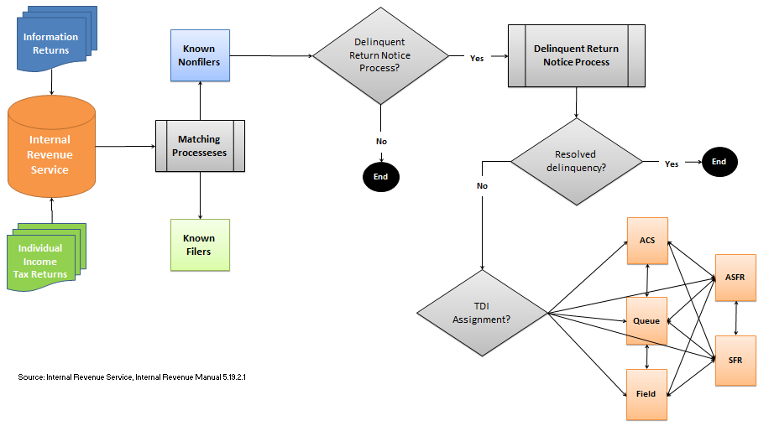

Slide 5
ASFR Background
Automated Substitute for Return (ASFR) is an automated system; a key program for enforcing filing compliance.
The taxpayers treated by the ASFR program have income and appear to have a tax liability and/or a filing requirement but have not responded to delinquent return notices.
The ASFR process sends up to two letters of notification to the taxpayer.
Letters provide detail on income and the proposed assessment amount the IRS will make if the taxpayer does not respond
If there is no response or resolution from the taxpayer on the first letter (ASFR 30-day letter) , the system prepares the Notice of Deficiency, which is mailed to the taxpayer as the ASFR 90-day letter
The end goal is to secure returns, collect unpaid tax liabilities, and promote future voluntary filing compliance.

Slide 6
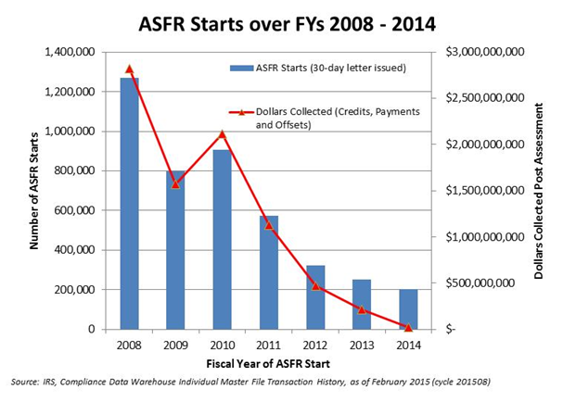
ASFR Starts (30-day letters issued) Fiscal Years 2008-2014
ASFR is working fewer cases
Securing less returns
Collecting fewer dollars
Decline in ASFR Resources
Steady decline in ASFR resources since 2010 as the graph demonstrates

Slide 7
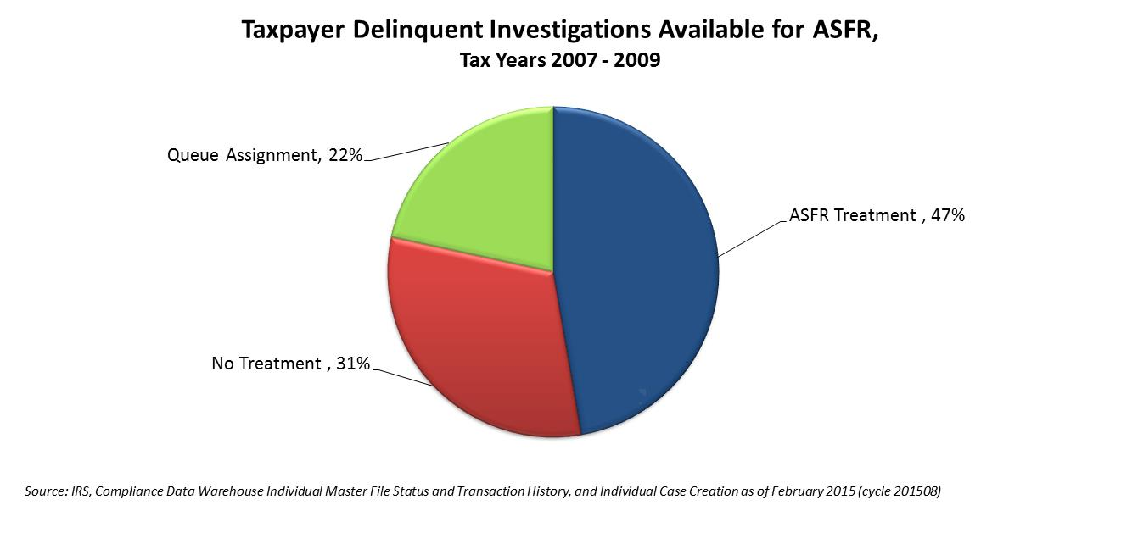
Taxpayer Delinquent Investigations Available ASFR Inventory

Slide 8
Research Objectives

Slide 9
Estimate impact on dollars collected for delinquent returns resulting from ASFR treatment
Estimate the impact on subsequent voluntary filing compliance resulting from ASFR treatment
Two, three, four years after delinquent return

Slide 10
Overview of ASFR Inventory Compliance/Collectability

Slide 11
Overview of Dollars Collected Three years from TDI status
Taxpayers treated by ASFR
were more likely to make a payment and
have higher average dollars collected
Compared to those not treated.

Slide 12
Overview of Voluntary Filing Compliance
Taxpayers who later file their delinquent return are more likely to voluntarily file subsequent returns
At least one third of the taxpayers treated by ASFR voluntarily filed subsequent return two, three, four tax years following a TDI

Slide 13
Theoretical Model

Slide 14
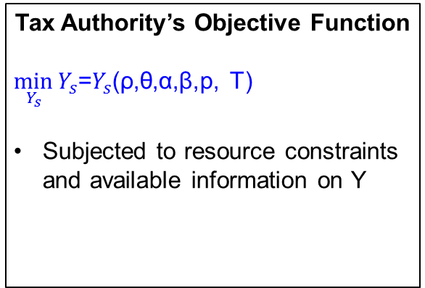
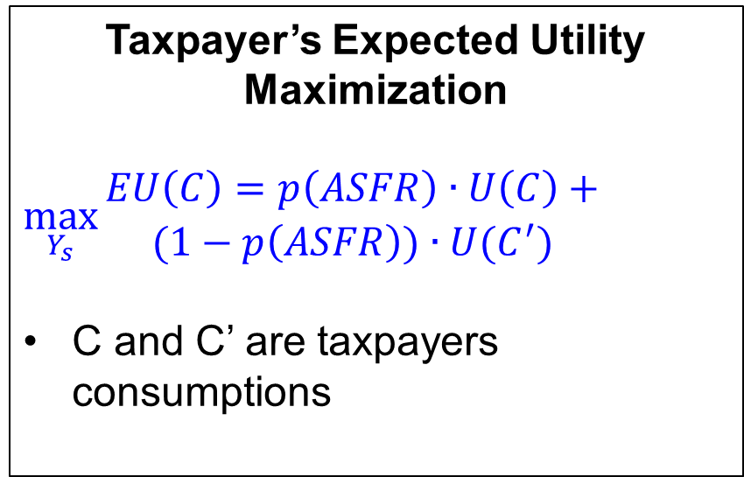
Taxpayer’s Expected Utility Maximization
$$\max_{Y_{s}}{\begin{aligned}EU\left(C\right)=p\left(ASFR\right)∙U\left(C\right)+ \\ (1−p\left(ASFR\right))∙U(C^{′})\end{aligned}}$$
C and C’ are taxpayers consumptions
Tax Authority’s Objective Function
$\min_{Y_{s}}{Y_{s}}$=$Y_{s}$(ρ,θ,α,β,p, T)
Subjected to resource constraints and available information on Y
Nash
Equilibrium
(if exists)
Y_{s}*
Y_{s}=(Y-W) suggests tax authority has no income information beyond W, that is Y_{r}=0. This is a case of non-filer

Slide 15
Empirical Model

Slide 16
Model 1: Probability of ASFR working a case from available inventory
Probit Regression
Using Tax Year dummies as instruments
Model 2: Net Dollars and Offsets Collected (within 3 years after TDI status)
Ordinary Least Square (OLS) Regression
Tobit Regression – Payments are left censored at zero dollars
Model 3: Subsequent Filing Compliance (voluntarily filed their tax )
Logistic Regression
Estimated separately two, three and four tax years after delinquency
X: vector of observable taxpayer characteristics
Direct Effect of ASFR
ASFR: indicator for ASFR treatment
Indirect Effect of ASFR
P(ASFR): predicted probability of ASFR working a case from available inventory

Slide 17

Empirical Model Net Dollars and Offsets Collected (within 3 years of TDI status)
β₁ and β₂ estimate the direct and indirect impacts of ASFR on Dollars Collected
OLS Model
Y_{i}= β₁ASFR_{i}+ β₂P(ASFR)_{i}+ X_{ik}β_{k}+e_{i}
The marginal impact on dollars collected is given by
x_{i} is a specific element of the set [ASFR_{i}, P(ASFR)_{i} , X_{ik}]
Tobit Model
Y_{i} = β₁ASFR_{i}+ β₂P(ASFR)_{i} + X_{ik}β_{k}+e_{i}
The marginal impact on dollars collected is given by
x_{i} is a specific element of the set [ASFR_{i}, P(ASFR)_{i} , X_{ik}] , Ф() is the Normal distribution function and σ_{U} is the scale parameter.

Slide 18
Empirical Model Subsequent Filing Compliance
Voluntarily filed the tax return two, three or four tax years after TDI
α₁ and α₂ estimate the direct and indirect impacts of ASFR on Subsequent Filing Compliance
P( File_{t+j})_{i}=F(α₁ASFR_{i}+ α₂P(ASFR)_{i}+ X_{ij}α_{j} ).
File_{t+j} represents whether the taxpayer timely filed their t+j tax return
Separate regression are estimated for j=2, 3 and 4
X matrix is updated for the each of the years with new available information
The marginal impact of x_{i} on subsequent filing compliance for each of these years are computed at their sample means

Slide 19
Model Results

Slide 20
Dollars Collected Model Results
Increase in Dollars Collected by ASFR Treatment:
Positive and Significant
Marginal Effects are positive on dollars collected for
ASFR treatments
compared to
“No Treatment”

Slide 21
Subsequent Voluntary Compliance Model Results
Increase in Subsequent Compliance by ASFR Treatment:
Positive, Significant
and Stable
Marginal direct and indirect effects of ASFR on voluntary filing compliance two, three and four years after TDI assignment
Indirect effect is increasing and stable over the years as the direct effect reduces over time

Slide 22
Illustrating the effect of ASFR with a Simulation

Slide 23
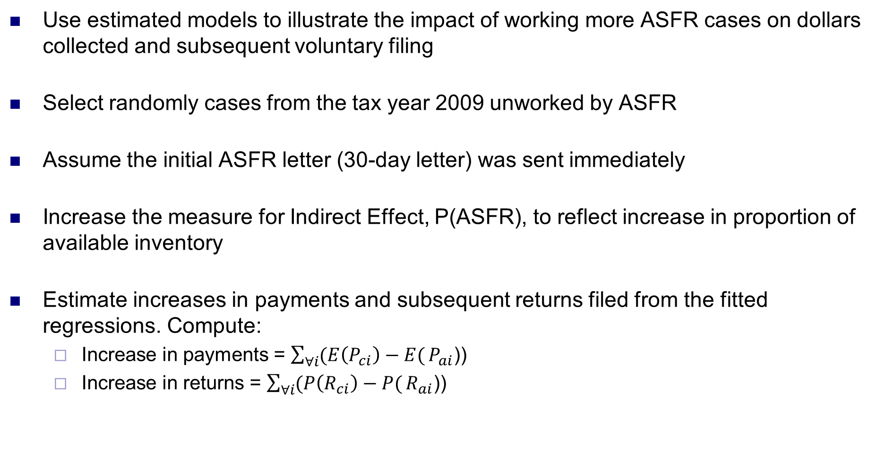
Simulation
Use estimated models to illustrate the impact of working more ASFR cases on dollars collected and subsequent voluntary filing
Select randomly cases from the tax year 2009 unworked by ASFR
Assume the initial ASFR letter (30-day letter) was sent immediately
Increase the measure for Indirect Effect, P(ASFR), to reflect increase in proportion of available inventory
Estimate increases in payments and subsequent returns filed from the fitted regressions. Compute:
Increase in payments = $\sum_{∀i}{(E\left(P_{ci}\right)−E(}P_{ai}$))
Increase in returns = $\sum_{∀i}{(P\left(R_{ci}\right)−P(}R_{ai}$))

Slide 24
Simulation Results
Increase in payments per case by working additional cases
Increase in voluntary subsequent compliance by working additional cases

Slide 25
Simulation – Return on Investment
Average cost to make an ASFR assessment is as much as $80
(Office of the Chief Financial Officer, Financial Management, Office of Cost Accounting, Cost-Based Performance Measures Automated Substitute for Return (ASFR) FY2009 - FY2013, Unpublished Internal CFO document, 2014)
Thus
Revenue collected relative to the cost is approximately (ignoring downstream treatment costs)
15:1 for Linear Model
40:1 using Tobit Model
Every $110 spent results in an additional voluntary filed return

Slide 26
Conclusions
Positive direct and indirect impacts of ASFR treatment
The indirect effects are smaller than the direct effects for payment of taxes on delinquent returns
The indirect effects on subsequent filing compliance are large relative to the direct effects
Both direct and indirect effects of ASFR remain high and stable on subsequent voluntary filing compliance
Simulation Results suggest working additional cases increases ASFR revenue per case and promotes subsequent voluntary filing compliance, which is stable across the years
Direction for further research:
Perform similar analysis by considering all the non-filer treatment steams and impact on all taxpayers, including those who have always filed timely or at least have always resolved in the notice process
Taxpayer’s expectations may depend on past probability of whether getting selected for treatment or not. This feature needs to be incorporated appropriately in the model
Extend the existing modeling framework by estimating dollars collected and subsequent voluntary compliance simultaneously in simultaneous equation framework

Slide 27
Thank You! Individual Non-Filers and IRS Generated Tax Assessments: Revenue and Compliance Impacts of IRS Substitute Assessment When Taxpayers Don’t File
Internal Revenue Service
Small Business / Self Employed, Collection Inventory Delivery & Selection , Strategic Analysis and Modeling
Saurabh Datta, Economist
Stacy Orlett, Operations Research Analyst
Alex Turk, Supervisory Economist
DISCLAIMER: The views and opinions presented in this paper reflect those of the authors.
They do not necessarily reflect the views or the official position of the Internal Revenue Service

